Slide 1
Transclusion

Slide 2
ngTransclude
Directive that marks the insertion point for the transcluded DOM of the nearest parent directive that uses transclusion.
You can specify that you want to insert a named transclusion slot, instead of the default slot, by providing the slot name as the value of the ng-transclude or ng-transclude-slot attribute.
Any existing content of the element that this directive is placed on, will be removed before the transcluded content is inserted.
This directive executes at priority level 0.

Slide 3
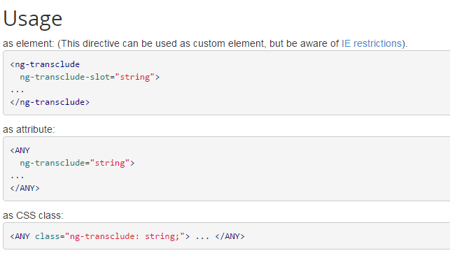

Slide 4
isolatedScope &
& or &attr - provides a way to execute an expression in the context of the parent scope. If no attr name is specified then the attribute name is assumed to be the same as the local name.
Given <widget my-attr="count = count + value">
and widget definition of
scope: { localFn:'&myAttr' },
then isolate scope property localFn will point to a function wrapper for thecount = count + value expression. Often it's desirable to pass data from the isolated scope via an expression to the parent scope, this can be done by passing a map of local variable names and values into the expression wrapper fn. For example, if the expression is increment(amount) then we can specify the amount value by calling the localFn as
localFn({amount: 22}).

Slide 5
Event propagation in Angular
AngularJS provides $on, $emit, and $broadcast services for event-based communication between controllers.

Slide 6
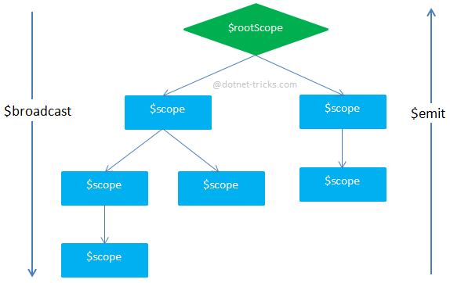
$emit
It dispatches an event name upwards through the scope hierarchy and notify to the registered $rootScope.Scope listeners. The event life cycle starts at the scope on which $emit was called. The event traverses upwards toward the root scope and calls all registered listeners along the way. The event will stop propagating if one of the listeners cancels it.

Slide 7
$broadcast
It dispatches an event name downwards to all child scopes (and their children) and notify to the registered $rootScope.Scope listeners. The event life cycle starts at the scope on which $broadcast was called. All listeners for the event on this scope get notified. Afterwards, the event traverses downwards toward the child scopes and calls all registered listeners along the way. The event cannot be canceled.
$on
It listen on events of a given type. It can catch the event dispatched by $broadcast and $emit.
Note
If there is no parent-child relation between your scopes you can inject $rootScope into the controller and broadcast the event to all child scopes but you cannot emit your event.
You can emit your event only when you have parent-child relation and event propagation is initiated by child. However, $emit can fire an event only for all $rootScope.$on listeners.

Slide 8
$watch, $watchGroup and $watchCollection
Angular uses $watch APIs to observe model changes on the scope. Angular registered watchers for each variable on scope to observe the change in its value. If the value, of variable on scope is changed then the view gets updated automatically. $watch APIs has following methods to observe model changes on the scope.

Slide 9
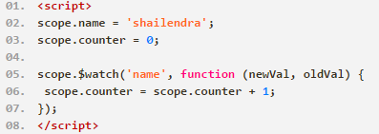
$watch
This function is used to observe changes in a variable on the $scope. It accepts three parameters: expression, listener and equality object, where listener and equality object are optional parameters.
$watch(watchExpression, listener, [objectEquality])
Here, watchExpression is the expression in the scope to watch. This expression is called on every $digest() and returns the value that is being watched.
The listener defines a function that is called when the value of the watchExpression changes to a new value. If the watchExpression is not changed then listener will not be called.
The objectEquality is a boolean type which is used for comparing the objects for equality using angular.equals instead of comparing for reference equality.

Slide 10
By default, the $watch() function only checks object reference equality. This means that within each $digest, AngularJS will check to see if the new and old values are the same "physical" object. This means that the vanilla $watch() statement will only invoke its handler if you actually change the underlying object reference.
The $watch() function takes a third, optional argument for "object equality." If you pass-in "true" for this argument, AngularJS will actually perform a deep-object-tree comparison. This means that within each $digest, AngularJS will check to see if the new and old values have the same structure (not just the same physical reference). This allows you to monitor a larger landscape; however, the deep object tree comparison is far more computationally expensive.

Slide 11
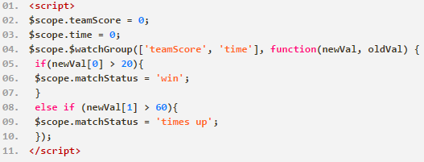
$watchGroup(watchExpressions, listener) ; (Angular1.3)
A variant of $watch() where it watches an array of watchExpressions. If any one expression in the collection changes the listener is executed.
The items in the watchExpressions array are observed via standard $watch operation and are examined on every call to $digest() to see if any items changes.
The listener is called whenever any expression in the watchExpressions array changes.

Slide 12
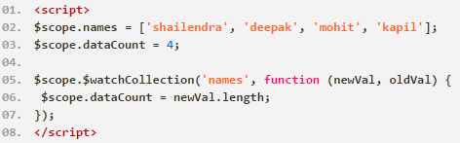
$watchCollection(obj, listener); (AngularJS 1.1.4 )
Shallow watches the properties of an object and fires whenever any of the properties change (for arrays, this implies watching the array items; for object maps, this implies watching the properties). If a change is detected, the listener callback is fired.
The obj collection is observed via standard $watch operation and is examined on every call to $digest() to see if any items have been added, removed, or moved.
The listener is called whenever anything within the obj has changed. Examples include adding, removing, and moving items belonging to an object or array.

Slide 13
the $watchCollection() function was added for collection-oriented change management. The $watchCollection() function is a sort-of mid-ground between the two $watch() configurations above. It's more in-depth than the vanilla $watch() function; but, it's not nearly as expensive as the deep-equality $watch() function. Like the $watch() function, the $watchCollection() works by comparing physical object references; however, unlike the $watch() function, the $watchCollection() goes one-level deep and performs an additional, shallow reference check of the top level items in the collection.

